Slide 1
Task 5: Mmap vs. Pipes vs. Threads
Jana Saleh 900204192
Mariam Dahab 900192441
Muhammad Azzazy 900202821

Slide 2
TABLE OF CONTENTS
01
02
03
04
05
06
ROLES
I/O OF MMAP
Role of every team member
Detailed description of the inputs and outputs of mmap
PSEUDOCODE
EXAMPLES
Pseudocode of the four compute functions
Simple examples of the four compute functions producing correct results
FIGURES
TESTS DESIGN
Figures illustrating the processes, threads, pipes, and the flow of data
How the two tests were designed and the ranges chosen

Slide 3
TABLE OF CONTENTS
07
08
09
10
SETTING N_PROC
SMOOTHING
How and why n_proc was set
Method of curve smoothing
RESULTS
Bonus
Comparison results and answers to the two questions
Comparison results

Slide 4
01
ROLES
Role of every team member

Slide 5
Name | Role
Jana Saleh | Implemented threads_compute
Mariam Dahab | Plotted the graphs comparing between the four compute functions and implemented the second part of the bonus
Muhammad Azzazy | Implemented mmap_compute

Slide 6
02
I/O OF MMAP
Inputs and outputs of mmap

Slide 7

INPUTS OF MMAP
The inputs of mmap are in the following order:
The address is set to 0 to allow the system to map anywhere it chooses.
The size is in our case (N+2)*unsigned long int, where N is the number of items in the file.
Some flags such as the following:
PROT_READ indicates whether the pages can be read from.
PROT_WRITE indicates whether the pages can be written to.
MAP_SHARED indicates whether the map is shared with the different processes.
MAP_ANONYMOUS indicates that the mapping is not backed by a file and the file descriptor is ignored.
The file descriptor is set 0 for standard input.
The offset which must be an integer multiple of the page size is set to 0, but since there is no file it does not matter.

Slide 8

OUTPUTS OF MMAP
The outputs of mmap are in the following order:
The numbers stored within the file
The results
The number of operations done

Slide 9
03
PSEUDOCODE
Pseudocode of the four compute functions

Slide 10
PSEUDOCODE OF MMAP_COMPUTE
MMAP_COMPUTE(n_proc, filepath[], f)
result ← 0
Number* head ← NULL
FILE* fh ← fopen(filepath, “r”)
N ← 0
while(!feof(fh))
do
fscanf(fh, “%lu”, &val)
append(&head, val)
N ← N + 1
unsigned long int *ptr ← mmap(NULL, (N+n_proc+1)*sizeof(unsigned long int), PROT_READ | PROT_WRITE, MAP_SHARED | MAP_ANONYMOUS, 0, 0)
if ptr == MAP_FAILED
then printf("Mapping Failed\n")
for i ← 1 to N
do
ptr[i] ← head->num
head ← head->next
for i ← 1 to n_proc-1
do
pid_t child_pid ← fork()

Slide 11
PSEUDOCODE OF MMAP_COMPUTE
if child_pid == 0
then If (N-1)/n_proc == 0
then ptr[N+i+1] ← (*f)(ptr[N+i], ptr[N+i+1])
else
for j ← 1 to (N-1)/n_proc
do
ptr[N+i+j+1] ← (*f)(ptr[N+i+j], ptr[N+i+j+1])
ptr[N+n_proc+1] ← ptr[N+n_proc+1]+1
exit(0)
wait(NULL)
for k ← ptr[N+n_proc] to N-1
do
ptr[N+n_proc] ← ptr[N+n_proc] + 1
ptr[k+1] ← (*f)(ptr[k], ptr[k+1])
result ← ptr[N]
munmap(ptr, (N+1)*(sizeof(unsigned long int)))
return result

Slide 12
PSEUDOCODE OF THREADS_COMPUTE
threads_compute( filepath, threads_number, (*f)(int, int)) {
file = fopen(filepath, "r")
while (fscanf(file, "%d", &m) != EOF)
nums[i] = m
i++
nums = realloc(nums, (i + 1) * sizeof(int))
fclose(file)
N = i
numbers_per_thread = N / threads_number
for i ← 0 to threads_number
first_num_inthread = i * numbers_per_thread
patialsum= 0
if i == threads_number - 1
last_num_inthread = N
else
last_num_inthread = (i + 1) * numbers_per_thread
for int i ← 0 to threads_number
for int j = first_num_inthread to th[i].last
numbers_in_thread[count] = numbers[j]
count++
// create threads
for i ← 0 i to threads_number
pthread_create(&threads[i], NULL, threadfun, (void *)&th[i])
// wait for threads to terminate
for i ← 0 to n_threads
pthread_join(threads[i], NULL)
pthread_mutex_destroy(&mut);
// add the sums of each thread and store it in sum_threads
for i ← 0 to n_threads)
total_ofThreads = f(total_ofThreads, partialsum)
return total_ofThreads

Slide 13
04
EXAMPLES
Simple examples of the four compute functions producing correct results

Slide 14
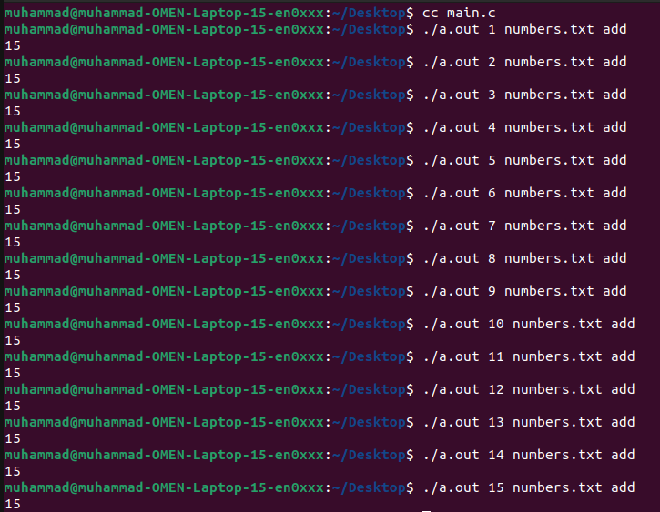
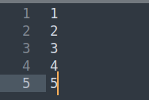
MMAP_COMPUTE EXAMPLE

Slide 15
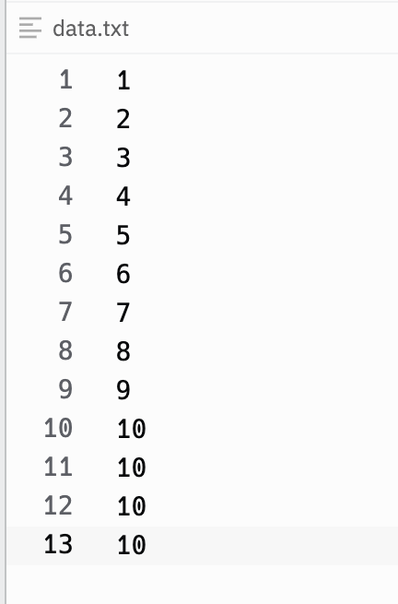
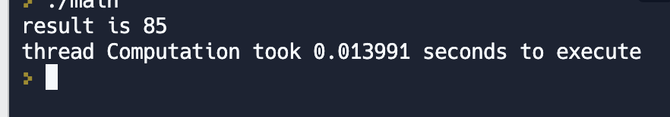
EXAMPLE OF THREAD_COMPUTE

Slide 16
05
FIGURES
Figures illustrating the processes, threads, pipes, and the flow of data

Slide 17
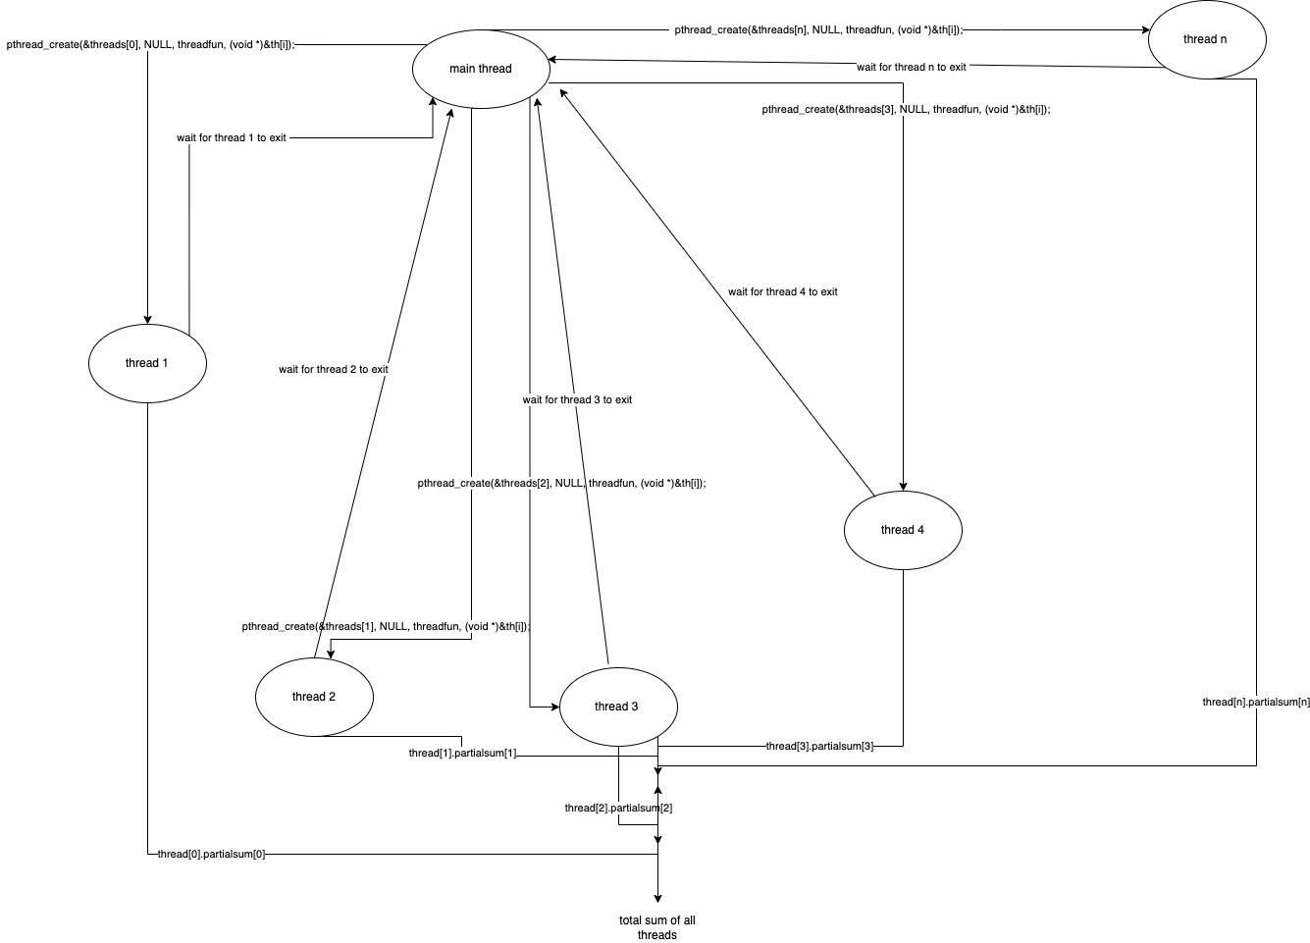
Figure of threads dataflow

Slide 18
06
TESTS DESIGN
How the two tests were designed and the ranges chosen

Slide 19
In the case of fixing N . The range of n_procs was chosen based on the capabilities of the computer (the number of cores) . All functions except sequential where given the same range of n_procs and all of them were give the same file containing N data.
In case of fixing n_procs . The range of N was set from the least value, which is 10, to the maximum value the computer can handle, which is 10,000. Again in each run, all functions where given the same file containing the same set of values from consistency.
In both cases the time of execution was gathered 10 times for each combination of numbers are the average was used as the final answer.

Slide 20
07
FIXING VALUES
Why was each value chosen

Slide 21
The value of n_proc (n_threads) was chosen based on the number of cores in the computer.
In this case the computer has a quad-core processor, and, therefore, the maximum number of threads that would have an effect is 4.
Similarly N was set to the maximum number that could be handled by the computer which is 10,000.

Slide 22
08
SMOOTHING
By running each set of values 10 times and taking the average . We were able to create a smooth curve for each line in the curve.

Slide 23
09
RESULTS
Comparing functions using the graphs

Slide 24
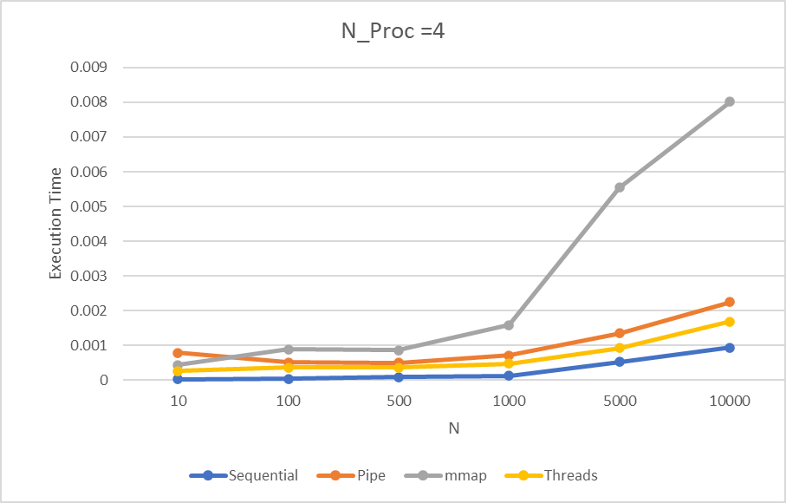
Fixing n_proc / n_threads to 4
Although we expected that one of the pipe/thread functions would be the fastest since the data is divided and processed concurrently.
However, the results different and the sequential took the least time out of the 4 from the beginning.
Again this is due to the fact that the number of cores limited the dividing of the data and we still believe that using different devices we may get different result.

Slide 25
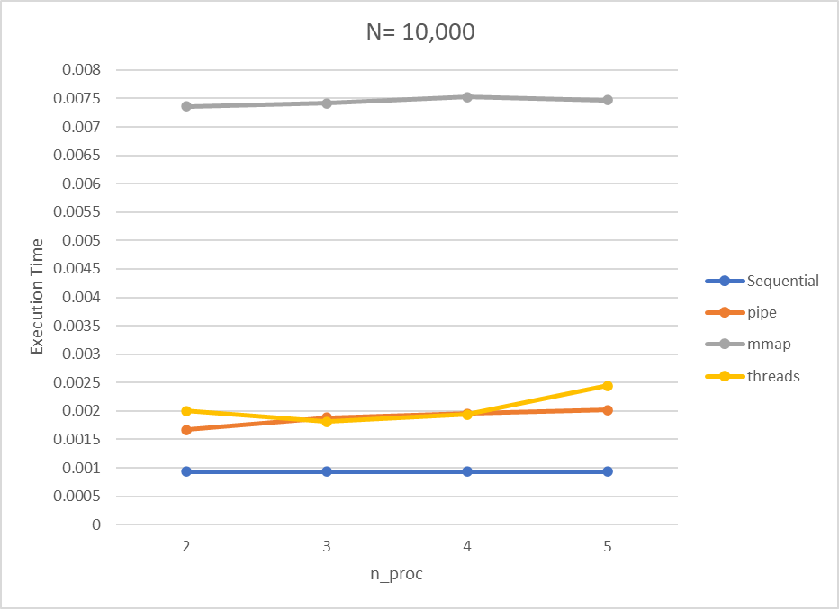
Fixing N to 10,0000
Although we expected that one of the pipe/thread functions would be the fastest since the data is divided and processed concurrently.
However, similar to the previous graph, the results came different and the sequential took the least time out of the 4 from the beginning.

Slide 26
10
BONUS
Comparing functions using the graphs

Slide 27
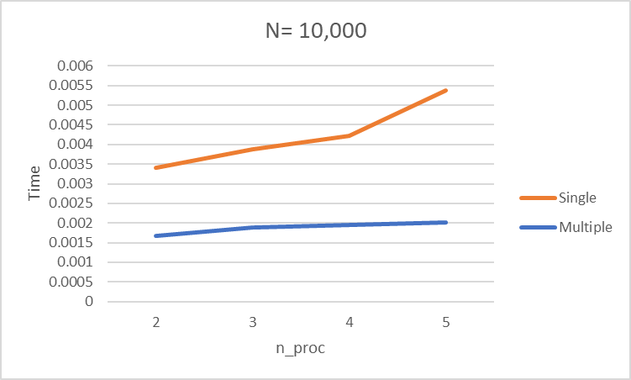
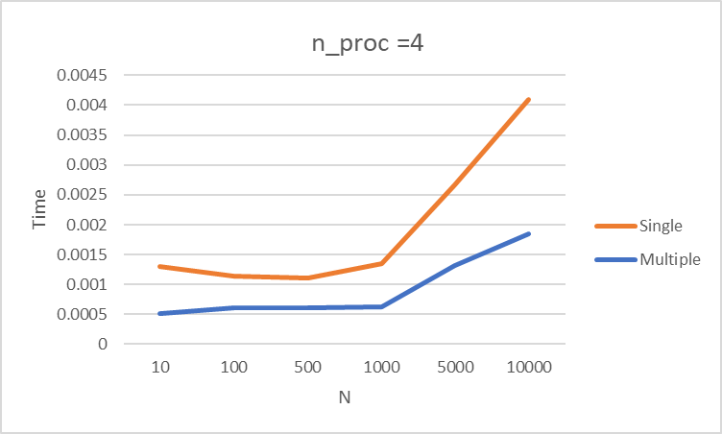
Since the single pipe function makes the parent until the created child is done before creating another one it is obvious that in both cases (fixing N and n_proc) the multiple pipe function would outpreform since the since can’t be considered as parallel computation

Slide 28
THANKS!
janasaleh@aucegypt.edu
mhdahab@aucegypt.edu
muhammad-azzazy@aucegypt.edu
Please keep this slide for attribution

